Slide 1
Design and Simulation of an Intelligent Traffic Signal Detection System Using Combinational Logic
2620030550-PALLAVI TENUGU
2620030524-JOSHIKA REDDY
2620030648-PRANAV

Slide 2
Introduction
Traffic congestion increases when signal timing is fixed and does not consider vehicle presence.
An intelligent traffic signal can detect traffic density and select an appropriate signal state.
Combinational logic is useful because the output depends directly on the current sensor inputs.
The proposed system uses simple sensors and logic gates to demonstrate automatic signal detection.
2

Slide 3
Objective
Design a basic intelligent traffic signal controller using combinational logic.
Use vehicle-detection sensors as binary inputs.
Develop logic conditions for selecting the traffic signal with higher traffic demand.
Create a truth table and logic-gate representation.
Simulate and verify the circuit using a digital simulation tool such as Logisim.
3

Slide 4
Theory:
An intelligent traffic signal system is designed to control traffic flow at road intersections by detecting the presence of vehicles and prioritizing emergency vehicles. It uses digital logic gates to process sensor inputs and produce the required traffic light outputs.
A combinational logic circuit is a digital circuit in which the outputs depend only on the present inputs, not on previous inputs or stored information.
In this project, sensors installed on two intersecting roads detect vehicles. An emergency sensor can also detect an ambulance or fire engine. The sensor signals are given to logic gates such as AND, OR, and NOT gates to decide which traffic signal should be green or red.

Slide 5
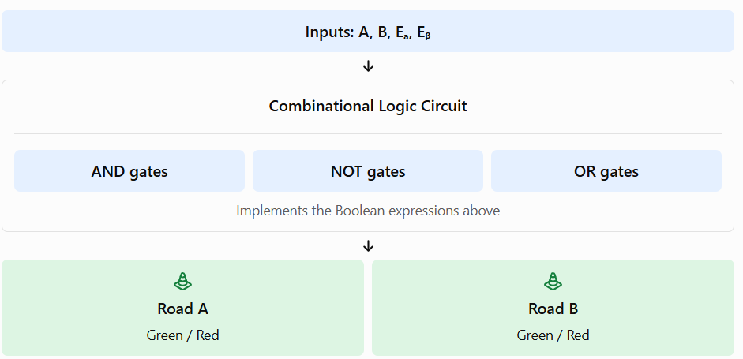
Logic Gates

Slide 6
Block Diagram
Road A Sensor
Combinational
Logic Circuit
Traffic Signal
Controller
Road B Sensor
Road C Sensor
Road D Sensor
5

Slide 7
Truth Table – Two-Road Demonstration
A | B | GA = A·B̅ | GB = B·A̅
0 | 0 | 0 | 0
0 | 1 | 0 | 1
1 | 0 | 1 | 0
1 | 1 | 0 | 0
Note: The 11 condition is handled by a separate priority/decision rule in a practical controller.
7

Slide 8
Applications and Limitations
Applications:
  Vehicle presence detection at junctions
  Smart traffic-light prototypes
  Educational digital-electronics demonstrations
Limitations:
  Basic combinational logic does not store traffic history.
  Real intersections need timers, pedestrian signals, safety interlocks, and more sensors.
  A larger system may require sequential logic or a microcontroller/PLC.
11

Slide 9
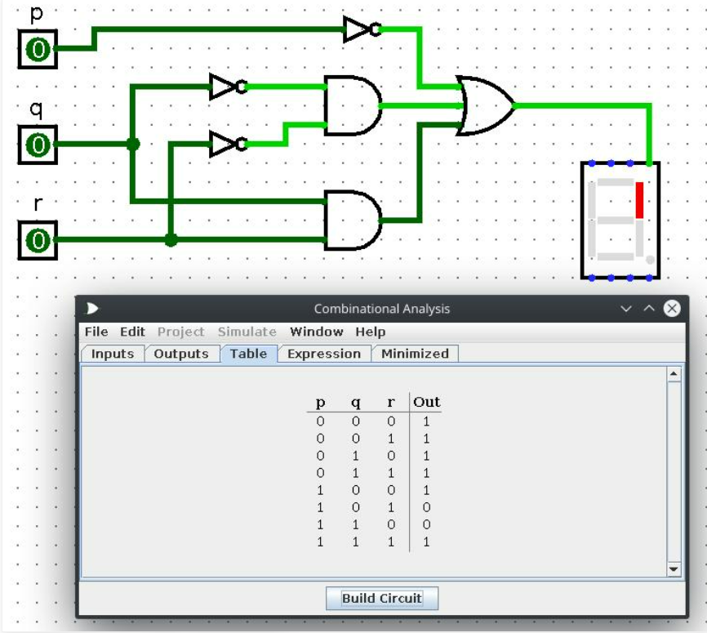
Simulation Result

Slide 10
Conclusion
An intelligent traffic signal can be modeled using sensor inputs and combinational logic.
Boolean expressions and truth tables provide a systematic way to design and verify the circuit.
Simulation helps confirm the logic before implementing hardware.
The project demonstrates how digital logic can be applied to a real-world traffic-control problem.
Future enhancement: add traffic-density levels, timers, pedestrian inputs, and priority control.
12

Slide 11
THANK YOU

